Slide 1

Joint with Mayukh Bagchi
DRTC, ISI, 2026
The Missing Long Tail
( of the Semantic Web)
Professor Fausto Giunchiglia, DISI, University of Trento, Italy.
Reach me: fausto.giunchiglia@unitn.it
Research Focus
Key Finding
Solution
Knowledge Graphs & Ontologies
Systemic Reuse Failure
Reuse via Compositionality

Slide 2
PRESENTATION OVERVIEW
Contents
01
The Semantic Web Vision
02
Long Tail in Healthy Ecosystems
From documents to data: understanding the original vision, the critical use-reuse distinction, and how the missing long tail represents systemic failure against the fractal vision.
Examining the universal pattern in natural languages, the World Wide Web, and scientific data—where healthy ecosystems support both universal and specialized needs.
03
The Missing Long Tail Evidence
04
Barriers to Ontology Reuse
Empirical analysis from AKSW LODStats and LOV revealing the statistical anomaly: <5% of ontologies account for >90% of reuse.
Understanding socio-technical obstacles: cost of ad-hoc use, top-down development, discoverability crisis, and institutional barriers.
05
Solution: Reuse via Compositionality
A paradigm shift for restoring the long tail through purpose-driven composition, enabling dynamic ecosystems of interoperable fine-grained ontology components.

Slide 3

CHAPTER 01
The Semantic Web
Vision
From Documents to Data:
Understanding the Foundation

Slide 4
FOUNDATIONAL CONCEPTS
The Original Vision and the Use-Reuse Gap
The 2001 Vision
Ontology Use
Tim Berners-Lee proposed transforming the WWW from "a web of documents to a web of data" with processable meaning (semantics).
The initial creation and deployment of an ontology within a specific project in a domain. Use has become mainstream in the WWW technological stack.
Globally distributed and interconnected ecosystem
Data shared, integrated, interpreted unambiguously by machines
Ontology Reuse
Shared ontologies as foundation for annotation and linking
The adoption, integration, and/or extension of an existing ontology into new projects within the same or overlapping domains.
The Critical Gap
The Fractal Vision
While use has become mainstream, reuse into Semantic Web applications and services is far from being a mainstream pattern . This gap represents the fundamental failure.
The Semantic Web was envisioned to be inherently fractal—composed of overlapping communities developing ontologies at multiple scales: global, community-specific, and local.

Slide 5
CHAPTER 02
Long Tail in
Healthy Ecosystems
Understanding the Pattern in Natural,
Social, and Technological Systems

Slide 6
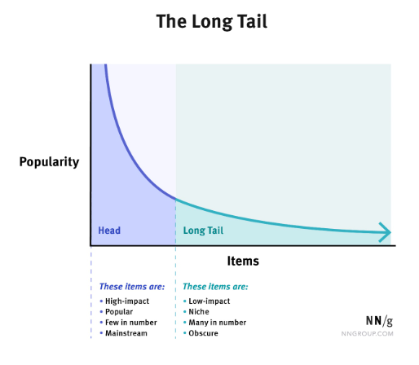
UNIVERSAL PATTERN
The Long Tail Distribution: A Universal Pattern
Defining the Long Tail
Illustration of a generic Long Tail
The long tail distribution is a pervasive feature of stable and mature information ecosystems. It is characterized by:
H
High-Frequency Big Head
Core elements with massive adoption and reuse
T
Lengthy Low-Frequency Tail
Specialized elements with minimal but meaningful reuse
Marker of Ecosystem Health
The presence of a long tail is a reliable diagnostic indicator of sustainability, signifying:
Key Insight
Flexibility
Adaptability
The long tail emerges not by accident but as a consequence of an ecosystem's ability to accommodate both universal and specialized needs.
Participation
Customization

Slide 7
ECOSYSTEM EXAMPLES
Long Tail in Natural Languages and the Web
Natural Languages: Zipf's Law
World Wide Web
In natural languages, the big head-long tail phenomenon manifests through Zipf's Law—a statistical pattern where a small number of words occur very frequently while many words occur rarely.
The WWW exhibits a healthy long tail where dominant platforms coexist with niche specialized content.
The Big Head: Dominant Platforms
The Big Head: Core Lexicon
A handful of platforms (Google, Facebook, Amazon) constitute the big head with billions of users accessing their general services.
Common words ("the", "be", "to") used and reused by all communicators, enabling universal communication across the language community.
The Long Tail: Niche Content
The Long Tail: Specialized Terminologies
• Specialized forums and communities
• Materials science terminology
• Personal blogs
• Legal contract language
• Academic repositories
• Molecular biology terms
• Niche e-commerce sites
• Subcultural dialects
Individually minimal traffic; collectively facilitate contextual knowledge reuse
• Regional geographic variants
Modern Recognition: Information retrieval systems (including LLMs) have explicitly recognized the value of this long tail, developing algorithms to expose relevant niche content alongside popular results.
This tail represents not fragmentation but expansive capacity for niche and contextual communication.

Slide 8
SCIENTIFIC ECOSYSTEM
Long Tail in Scientific Data: Dark Data Value
The Long Tail of Science
Scientific Data Distribution
Scientific data exhibits a pervasive long tail phenomenon, with large-scale collaborative projects forming the big head and countless specialized datasets from individual labs constituting the tail.
Big Head Examples
Long Tail Examples
• Neuroscience databases
• Individual lab datasets
• Genomic databases
• Field study observations
• Particle physics data
• Specialized measurements
Critical Value of Dark Data
Dark Data in the Long Tail
Dark data is not negligible. In aggregate, it represents:
The concept of "dark data" refers to specialized datasets that are:
Vast repository of detailed evidence
Poorly indexed across data catalogs
Critical for reproducibility
Stored in ad-hoc formats
Essential for meta-analysis
Difficult to discover and access
Unexpected discovery through recombination
Addressing narrow, specific research questions
Growing Recognition: The emphasis on open science and data sharing acknowledges that the scientific process critically depends on reusing this long tail.

Slide 9
SYNTHESIS
Common Principle: Specialization and Decentralized Reuse
The Consistent Principle Across Healthy Ecosystems
A consistent principle emerges from diverse cases: the long tail embodies specialization, contextual adaptation, and decentralized reuse .
Specialization
Contextual Adaptation
Decentralized Reuse
The long tail represents diverse communities pursuing their own particular goals within a shared ecosystem.
Long tail elements adapt to specific contexts and needs without fragmenting the overall ecosystem coherence.
Healthy ecosystems provide mechanisms for effective discovery and relevant reuse of niche elements into broader contexts.
Examples:
• Niche terminology in languages
Characteristics:
Mechanisms:
• Specialized forums on the web
• Purpose-specific modifications
• Search and discovery systems
• Domain-specific datasets in science
• Local optimizations
• Quality indicators and metadata
• Community-driven evolution
• Integration pathways
Key Insight
The statistical distribution is a natural outcome of diverse communities pursuing their own particular goals. A long tail indicates that the ecosystem provides mechanisms for effective discovery and relevant reuse of niche elements into broader contexts.

Slide 10
CHAPTER 03
The Missing Long
Tail Evidence
Empirical Analysis of Ontology
Reuse Patterns

Slide 11
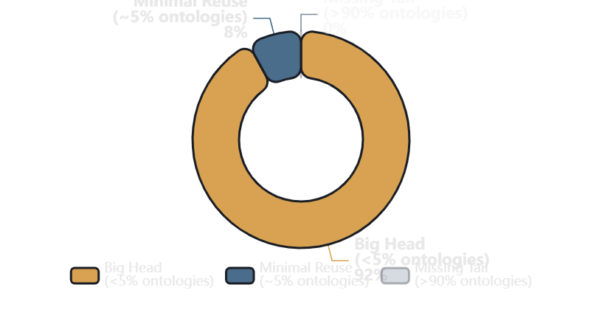
EMPIRICAL FINDING
Statistical Anomaly in the Semantic Web
The Core Finding
Ontology Reuse Distribution
The Semantic Web presents a statistical anomaly when examined through the lens of long-tail distribution. Unlike healthy ecosystems, it exhibits what we term the "missing long tail."
The Distribution Reality
The Big Head
<5%
of all registered ontologies account for >90% of actual reuse
• FOAF (Friend Of A Friend)
• Dublin Core terms
• schema.org
What This Absence Signifies
This absence is not a minor statistical deviation but a fundamental characteristic that reveals:
The Missing Tail
>95%
of ontologies show no recorded reuse
Systemic failure to achieve universal interconnection
Exist as published and initially used but fail to function as continually reused resources
Inability to serve specialized needs alongside general needs
Lack of mechanisms for effective discovery and reuse

Slide 12
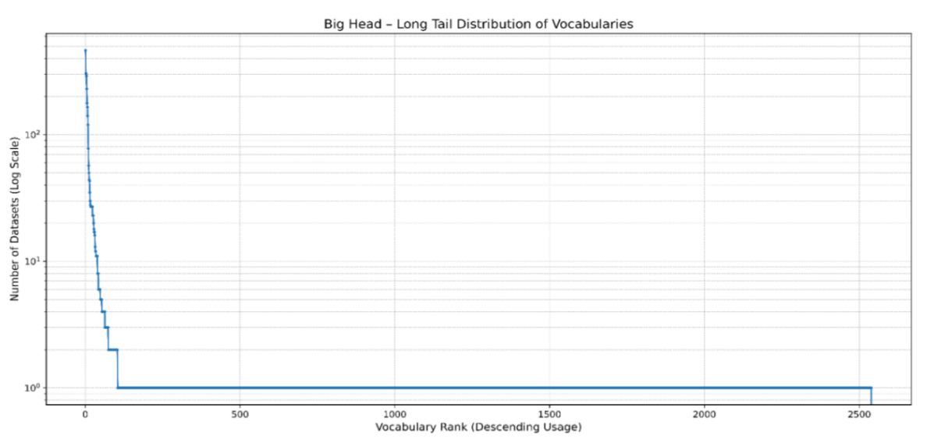
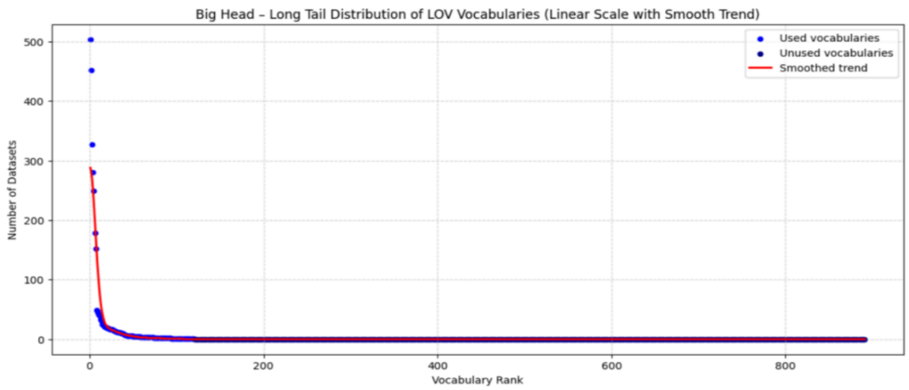
DATA ANALYSIS
Empirical Evidence: AKSW LODStats and LOV Analysis
AKSW LODStats
Linked Open Vocabularies (LOV)
Dataset Overview
Dataset Overview
Total Vocabularies
Analysis Type
Repository Type
Metric
2,593
Log-linear plot
Curated catalog
Dataset usage
Key Observations
Key Observations
• Sharp initial decline: High reuse of top ontologies (FOAF, Dublin Core)
• Steep decline: Small set of high-ranking ontologies form the big head
• Extended flat tail: Most vocabularies have near-zero to zero reusage
• Long flat tail: Vast majority used but not reused
• Visual confirmation: Published but non-reused ontologies
• Consistent pattern: Confirms LODStats findings
The LODStats visualization clearly depicts the missing long tail phenomenon with a steep drop-off followed by a prolonged flat line representing thousands of unused ontologies.
Cross-Validation: Both repositories independently confirm the same statistical anomaly, ruling out dataset-specific biases.
Visual Pattern Recognition
Both visualizations show a steep initial decline in reuse frequency that collapses into a nearly flat, low-to-zero-reuse line for the vast majority of resources—a graphical representation of the missing long tail.

Slide 13
CHAPTER 04
Barriers to
Ontology Reuse
Understanding Socio-Technical
Obstacles

Slide 14
ECONOMIC BARRIER
The Cost of Ad-hoc Use: A Self-Reinforcing Cycle
Defining the Cost of Ad-hoc Use
Long-Term Consequences
Developing a new, project-specific ontology (i.e., ad-hoc use) is often:
Incompatible Datasets
Cheaper
Faster
Each project uses its own ontology, creating data silos
than discovering existing ones
than integration efforts
Duplicated Efforts
This is true in spite of increased redundancy and fragmentation of the overall ecosystem.
Same concepts modeled repeatedly across domains
Missed Interoperability
Opportunities for cross-domain integration lost
The Self-Reinforcing Cycle
1
Ontologies designed without reuse in mind
Multi-contextual Integration Challenge
2
High cost of adapting them in later cycles
In multi-contextual data integration scenarios, the effort required to map, align, and reconcile overlapping ad-hoc used ontologies across projects remains a significant socio-technical barrier.
3
Incentivizes ad-hoc use instead of reuse
4
Cycle repeats, reinforcing the missing long tail
This has been identified as a key challenge in fractal ontology development—communities cannot effectively build upon each other's work.

Slide 15
ARCHITECTURAL BARRIER
Top-Down Development: The All-or-Nothing Proposition
Mainstream Ontology Engineering
The All-or-Nothing Dilemma
The mainstream practice has been to create comprehensive, self-contained models intended to cover an entire domain.
The absence of a general mechanism for granular reuse means ontology adoption becomes an all-or-nothing proposition:
Characteristics:
Scenario A: Full Adoption
• Internal logical consistency prioritized
Developer adopts an entire purpose-agnostic ontology just to use a single term
• Large, monolithic structures
• Domain-complete coverage goals
Scenario B: Local Recreation
• Minimal external dependencies
Developer forgoes reuse and recreates the concept locally, contributing to fragmentation
Granularity Problem
Developer needs:
The Integration Challenge
A single term for a rare phenomenon
While ensuring internal consistency, this approach results in large, inflexible ontologies that are:
Difficult to extend or adapt
Hard to combine with other ontologies
Current options:
Requiring complex alignment efforts
• Adopt 10,000+ term ontology
• Create new term (no reuse)
Demanding significant domain expertise
Result: High cost → No reuse

Slide 16
VISIBILITY BARRIER
Discoverability Crisis and Invisible Ontologies
The Invisibility Problem
Missing Discovery Infrastructure
While popular big head vocabularies benefit from standardization, academic citations, and tool integration, the vast majority of ontologies remain effectively invisible .
The lack of an integrated, stratified ecosystem prevents effective discovery:
Rich Metadata
Insufficient description of ontology content, scope, and quality
Fragmented Publication
Usage Statistics
Ontologies are published across:
No visibility into which ontologies are actually being reused
• Project websites
• Institutional repositories
Quality Indicators
• Personal/research group pages
Lack of metrics for assessing ontology reliability and maturity
• Academic papers (supplementary)
Fine-Grained Search
Cannot search for specific classes, properties, or patterns
Catalog Limitations
Even centralized catalogs function more as catalogs of publication than as curated catalogs for active discovery.
Result: Issues in discoverability lead to duplication of modeling effort and reinforcement of the missing long tail.

Slide 17
SOCIAL & INSTITUTIONAL BARRIERS
Socio-Institutional Barriers to Reuse
Academic Reward System
Unsustainable Business Models
Specialized Skill Requirements
The task of maintaining an ontology requires continual initiative and self-reinforcing ecosystem.
The skillset involved in ontology evaluation, reuse, and integration should not be underestimated.
The academic and professional reward ecosystems are oriented towards creation, not reuse .
Required Expertise:
Maintenance Requirements:
• Conceptual coherence assessment
• Updates for domain changes
• Logical soundness verification
• Error fixing and quality assurance
• Fit-for-purpose evaluation
Publications for new ontology development
• User support and documentation
Citations for novel contributions
• Ensuring discoverability
Technical Skills:
Limited recognition for reuse efforts
• Modeling logics
• Knowledge representation
No metrics for integration impact
Big Head Sustainability:
• Semantic Web technologies
Only well-funded projects (DCMI, schema.org consortium) can sustain maintenance.
Scarcity Problem:
These skills are not common among data scientists or domain experts, creating a barrier to entry.
Impact: Researchers are incentivized to create new ontologies rather than invest effort in discovering and reusing existing ones.
Long Tail Reality:
Small research group ontologies become outdated and obsolete due to funding termination.
Tool Gap: User-friendly tools for visualizing, comparing, and reusing ontologies assume expertise in tools like Protégé.

Slide 18
CHAPTER 05
Solution: Reuse via
Compositionality
A Paradigm Shift for Establishing
the Long Tail

Slide 19
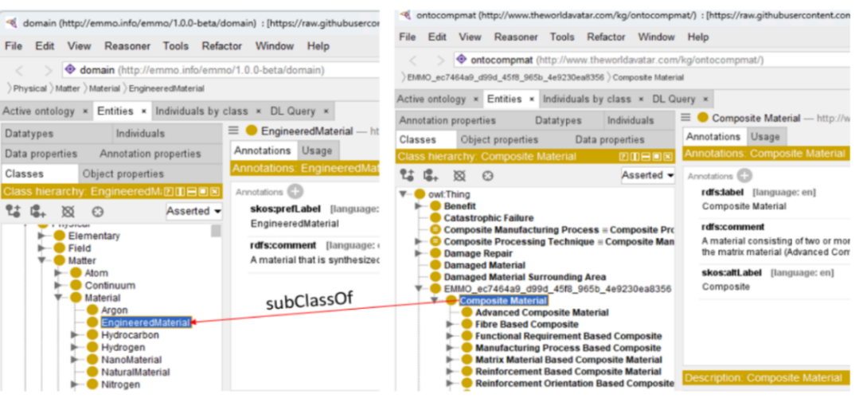
PARADIGM SHIFT
Purpose-Driven Composition: The Core Mechanism
Defining Compositionality
JIDEP (HORIZON EUROPE):
Materials Science
Compositionality is the principle whereby the meaning of a complex expression is determined by:
Scenario
Reuse the concept of Composite Material from the specialized Composite Materials Ontology (CMO) by composing it with Engineered Material from the Elementary Multiperspective Material Ontology (EMMO).
1
The meanings of its constituent parts
2
The rules used to combine them
Benefit 1: No Full Commitment
Reuse single concept without adopting entire CMO with JIDEP-specific concepts
The Transition
This principle enables a transition from:
Benefit 2: No Ad-hoc Recreation
Avoid modeling new concept when one is already available
Current Model
Target Model
Big head highly popular monolithic ontologies
Dynamic ecosystem of fine-grained components
Result: Directly increases integration and eliminates missing reuse
Directly Targets Core Barriers
This approach directly targets the core barriers contributing to the missing long tail, including—most importantly—reducing and, in time, eliminating, the cost of ad-hoc use.

Slide 20
IMPLEMENTATION FRAMEWORK
Three Layers of Composition Implementation
1
2
3
Language Layer
Knowledge Layer
Data Layer
Flexible Term Combination
Modular Decomposition
Purpose-Specific Integration
Support the flexible combination of vocabulary terms from diverse namespaces.
Decompose large integrated models into reusable self-contained modules encoding specialized conceptualizations.
Enable purpose-specific integration of instance data from multiple heterogeneous Knowledge Graphs.
Instead of committing an application to a single big head vocabulary, developers can selectively import and compose terms from multiple sources that best fit their purpose.
An ontology modeller can compose only relevant modules for a specific purpose without adopting entire ontologies.
Current Bottleneck:
Requiring data transformation and loading into a single unified ontology prior to querying
Example:
Example:
Compositional Approach:
Public health app combines terms from biomedical ontology + social determinants vocabulary + geographical ontology
Environmental science ontology separates modules for chemical entities, ecological processes, geographic features
Query across distributed, heterogeneous sources without upfront unification
Reduces cost at terminological level
Reduces cost at entity type level
Reduces cost at knowledge representation level

Slide 21
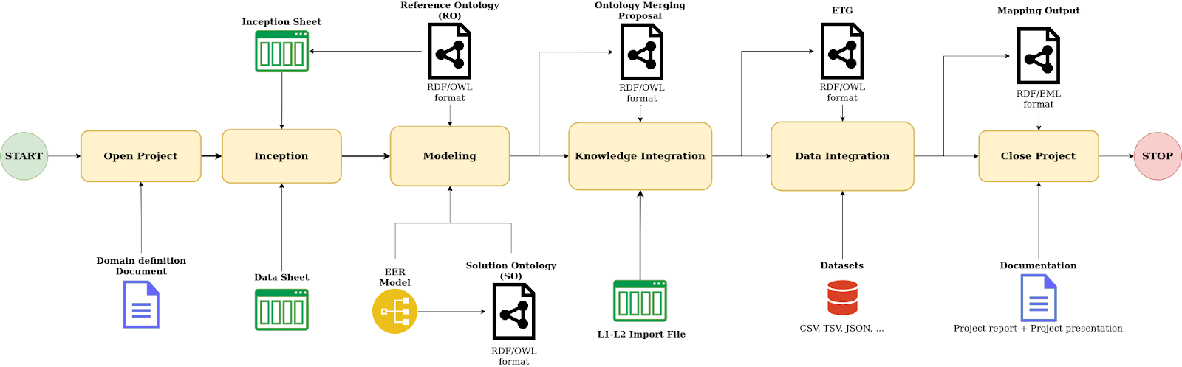
iTelos: Stratified Data Integration Methodology
Note : An evaluation step is considered within the execution of each activity. If the evaluation is not acceptable, the process will return to the previous activity.

Slide 22
IMPLEMENTATION CHALLENGES
Challenges
Technical Challenges
Educational Evolution
New Logic Development
Educational initiatives must evolve to train a new generation of practitioners in:
Requires development of novel logical frameworks for purpose-driven reuse and stratified composition
Compositional Thinking
Modular Design
Methodology Innovation
Reuse Methodologies
Integration Skills
New methodologies needed for composing pieces of namespaces and ontologies toward data integration
Example: Knowledge Graph master degree courses incorporating compositional principles
Tool Development
User-friendly tools for visualization, comparison, and composition of ontology fragments
The Fractal Vision ?
Social & Institutional Challenges
Our proposal is the realization of the empirically unfulfilled fractal vision of the Semantic Web.
Creating incentives for modular ontology development
Establishing communal practices for sharing fine-grained components
Operationalizes the fractal vision through purpose-driven compositionality
Developing sustainable business models for decentralized resources
Enables reuse that fractal ontologies naturally require
Building co-curation infrastructure (DataScientia Initiative)
Achieves at scale what has been unrealizable to date
The Key Enabler: Purpose-Driven Composition
Composition without a purpose leads to combinatorial explosion and semantic incoherence. A clear, articulated purpose serves as a selection function, guiding which ontology components are relevant and how they should be composed.

Slide 23
CONCLUSION
Establishing the Long Tail
The Diagnosis
The Solution
The pervasive presence of long tails in language, science, and digital content demonstrates that successful information ecosystems naturally evolve to support both universal and specialized needs.
Restoring the long tail requires a paradigm shift from big head ontology adoption toward reuse via composition .
The Vision Achieved
The Problem
This restoration is:
A prerequisite for achieving the original vision of a globally interconnected web of machine-readable knowledge
The absence of this pattern in the Semantic Web—the missing long tail of ontology reuse —reveals a fundamental socio-technical failure and not merely a lack of domain diversity.
Essential for building robust, trustworthy AI systems that operate across general and specialized domains
"The path forward requires not just technological innovation, but a fundamental rethinking of how we create, share, and reuse knowledge in the Semantic Web ecosystem."

Slide 24



DRTC, ISI, 2026
The Missing Long Tail
of the Semantic Web
Professor Fausto Giunchiglia, DISI, University of Trento, Italy.
Reach me: fausto.giunchiglia@unitn.it
Research Focus
Key Finding
Solution
Knowledge Graphs & Ontologies
Systemic Reuse Failure
Reuse via Compositionality
The research leading to these results has received funding from the European Union’s Horizon 2020 Research and Innovation Programme, through the TRUMAN project, under Grant Agreement No. 101214000. The contents of this publication are the sole responsibility of the University of Trento and do not necessarily reflect the opinion of the European Union.

